Slide 1
Analysis of Domino’s Pizza Dashboard
By- PrashanT Kumar
to- mr. Divakar kushwaha
Course- DaTa Science
Date – 01/03/2025

Slide 2
Content
POWER BI DESKTOP TOOLS ARE USED
DASHBOARD AGENDA
DASHBOARD PERFORMANCE
DASHBOARD SNIPPETS
SKILLS LEARNED
ACKNOWLEDGE

Slide 3
POWER BI TOOLS ARE USED
Data Connectivity & Transformation
Power Query Editor – Used for data cleaning, transformation, and modeling.
Data Sources – Connect to various data sources like Excel, CSV etc.
DAX (Data Analysis Expressions) – Used for creating custom calculations, measures, and calculated columns.
Data Modeling & Relationships
Data Model View – Helps define relationships between different tables
Measures & Calculated Columns – Created using DAX for deeper insights.
Visualization Tools
Visualizations Pane – Includes bar charts, pie charts, maps, tables, KPIs, and more.
Slicers & Filters – Enable dynamic data filtering.

Slide 4
Dashboard AGENDA
What are the monthly sales trends for Domino’s pizzas?
Which size of pizza is ordered the most?
What are the top 5 best-selling pizzas based on quantity sold?
Which pizza category (e.g., Classic, Veggie, Supreme) generates the most revenue?
What is the total revenue generated from all pizza orders?
What is the average order value per customer?
What is the distribution of orders across different hours of the day?

Slide 5
DASHBOARD PERFORMANCE
Total Sales & Revenue Trends – Track overall sales and growth
Monthly sales trends for Domino’s pizzas Are shown by card, gaugachart.
By Using the COLUMN CHART to show the top 5 best-selling pizzas based on quantity sold
Show the peak time of pizza order by using the line chart.
We Use the slicers in dashboard for (Pizza_Categroy, Month_Name, Pizza_Size).
We use the cards to show the Total no. of order, Avg order value, Avg Pizza per order.

Slide 6
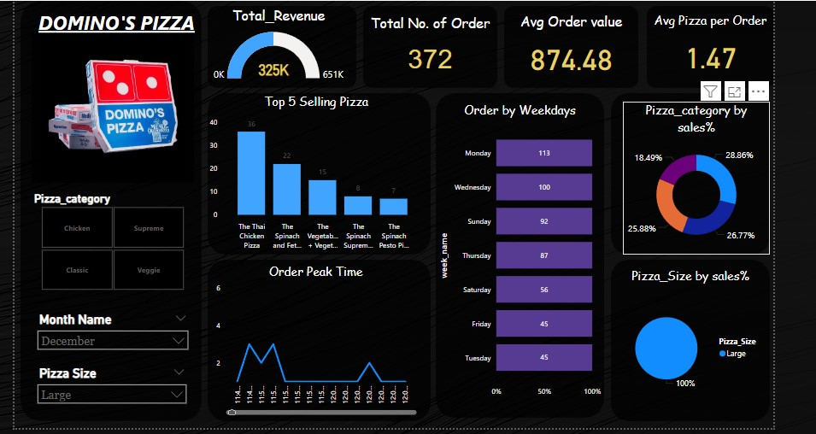
DASHBOARD SNIPPETS

Slide 7
SKILLS LEARNED
Power BI Proficiency – Building interactive dashboards.
Data Cleaning & Transformation – Using Power Query to clean messy data.
DAX (Data Analysis Expressions) – Creating calculated columns and measures.
Charts & Visualizations – Designing bar charts, pie charts, KPIs, Donut chart, etc.
Drill-Down & Filtering – Implementing slicers, drill-through, and hierarchy views.
Presenting data-driven insights effectively.

Slide 8
ACKNOWLEdgement
I WOULD LIKE TO EXPRESS MY SPECIAL THANK TO MY TEACHER ‘MR.DIVAKAR KUSHWAHA SIR’ AT DUCAT IT TRAINING SCHOOL FOR THEIR INVALUABLE GUIDANCE, INSIGHTFUL MATTERSHIP THROUGHOUT THE POWER BI COURSE TO PRESENT THIS PROJECT TITLE – ANALYSIS OF A DOMINO’S PIZZA DASHBOARD WITH THE UTMOST KNOWLEDGE. THEY DEDICATION TO TEACHING AND THEIR ABILITY TO SIMPLIFY COMPLEX CONCEPTS IN HELPING ME TO DEVELOP MY SKILLS.

Slide 9
Thank you

